Slide 1
Theory of Automata
Lecture # 7-8

Slide 2
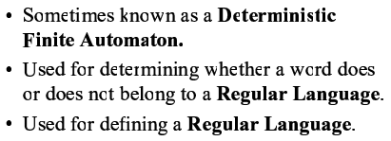
Finite Automata

Slide 3
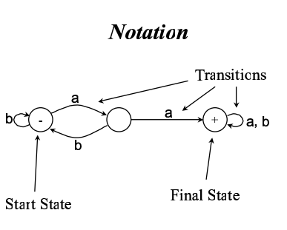
Notations used in FA

Slide 4
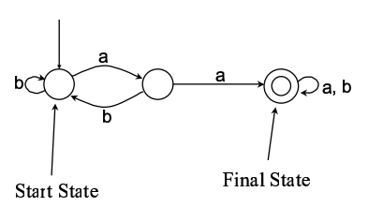
Alternative notations

Slide 5
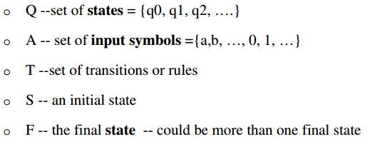
finite state machine consists of M=(Q,A,T,S,F)

Slide 6
Language accepted by FA
String is accepted by a FA if and only if the FA starting at the initial state and ends in an accepting state after reading the string.

Slide 7
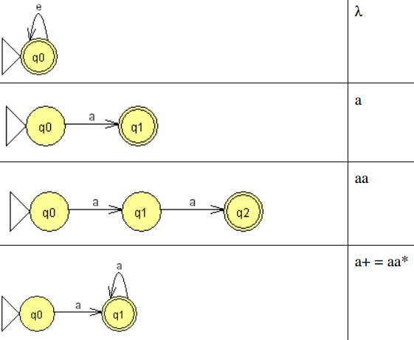
Examples of languages accepted by FA
FA
RE
Notes:
Lambda or twice Lambda or thrice Lambda or ……. All are equal to Lambda

Slide 8
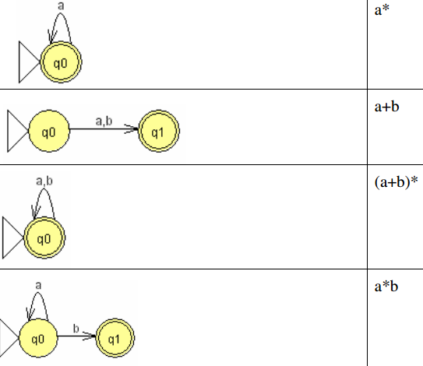
Examples of languages accepted by FA
FA
RE

Slide 9
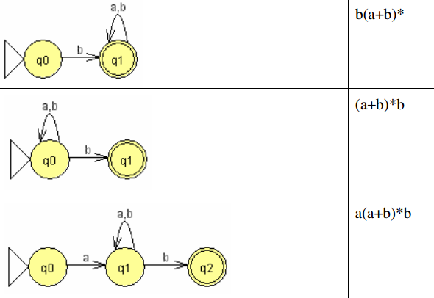
Examples of languages accepted by FA
FA
RE

Slide 10
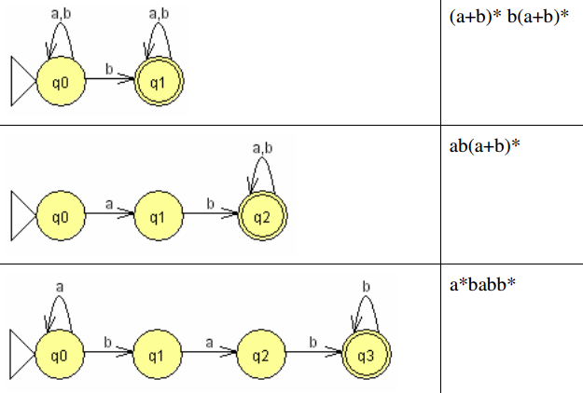
Examples of languages accepted by FA
FA
RE

Slide 11
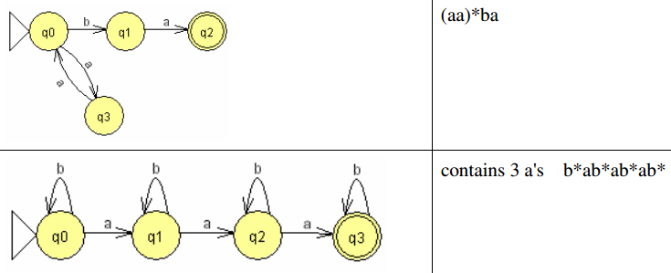
Examples of languages accepted by FA
FA
RE

Slide 12
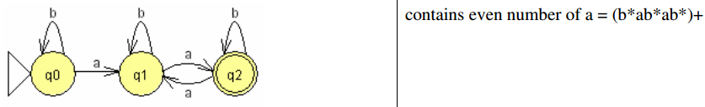
Examples of languages accepted by FA
FA
RE

Slide 13
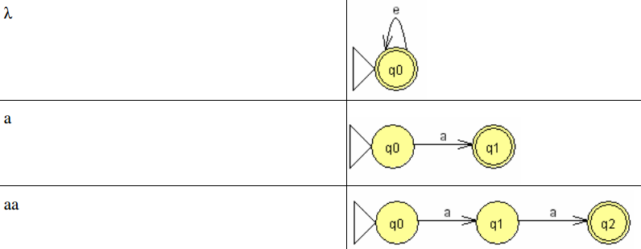
Converting Regular Expression into a Finite Automata
RE
FA

Slide 14
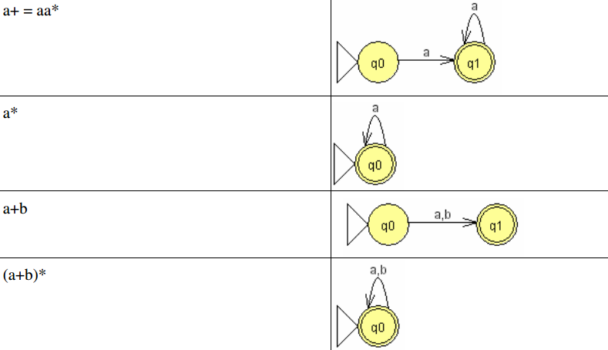
Converting Regular Expression into a Finite Automata
RE
FA
Notes:
First diagram is NFA

Slide 15
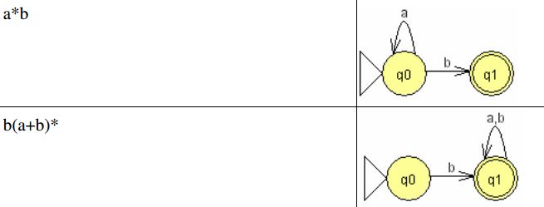
Converting Regular Expression into a Finite Automata
RE
FA
Notes:
Second is NFA

Slide 16
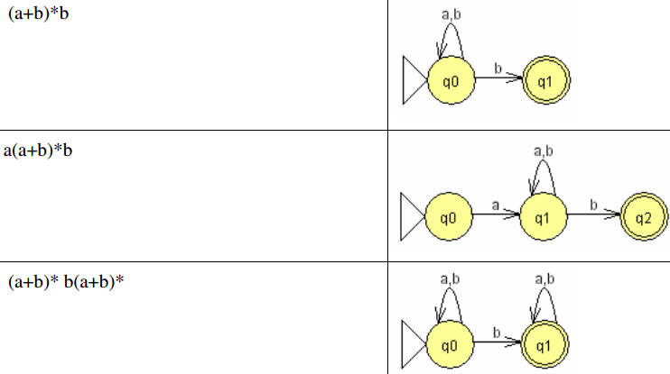
Converting Regular Expression into a Finite Automata
RE
FA
Notes:
ALL these diagrams are NFA

Slide 17
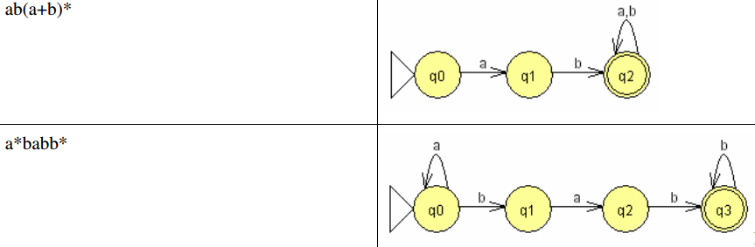
Converting Regular Expression into a Finite Automata
RE
FA
Notes:
ALL these diagrams are NFA

Slide 18
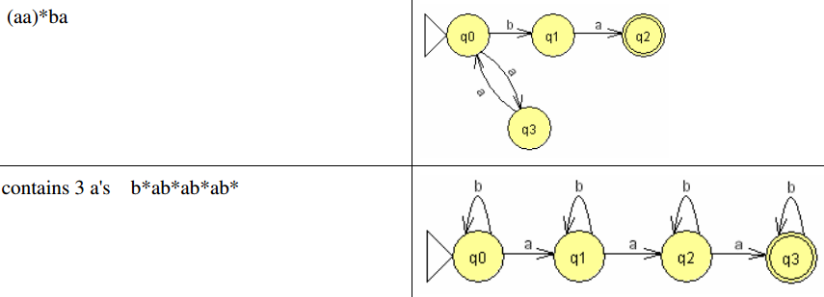
Converting Regular Expression into a Finite Automata
RE
FA

Slide 19
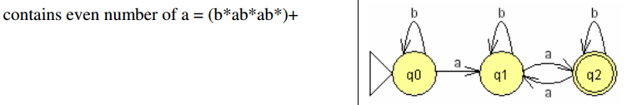
Converting Regular Expression into a Finite Automata
RE
FA

